Slide 1
Starting an Open Source Project (FOSS Milestone 1)
Anjan Debnath
Sr. Software Engineer

Slide 2
What does open source mean?
When a project is open source, that means anybody can
view,
use,
modify, and
distribute
your project for any purpose.

Slide 3


Example
imagine your friend is having a potluck, and you bring a cherry pie.
Everybody tries the pie (use)
The pie is a hit! They ask you for the recipe, which you provide (view)
One friend, Alex, who’s a pastry chef, suggests reducing the sugar (modify)
Another friend, Lisa, asks to use it for a dinner next week (distribute)

Slide 4
Why do people open source their work?
Collaboration: Open source projects can accept changes from anybody in the world.
Adoption and remixing: Open source projects can be used by anyone for nearly any purpose. People can even use it to build other things. WordPress, for example, started as a fork of an existing project called b2.
Transparency: Anyone can inspect an open source project for errors or inconsistencies.

Slide 5
Does open source mean “free of charge”?
Most open source projects are free, but “free of charge” is not part of the open source definition.
There are ways to charge for open source projects indirectly through dual licensing or limited features,

Slide 6
Launching your own open source project
Every open source project should include the following documentation:
Open source license
README
Contributing guidelines
Code of conduct
If your project is on GitHub, putting these files in your root directory with the recommended filenames will help GitHub recognize and automatically surface them to your readers.
You can open source a work in progress, or after years of being closed source.

Slide 7
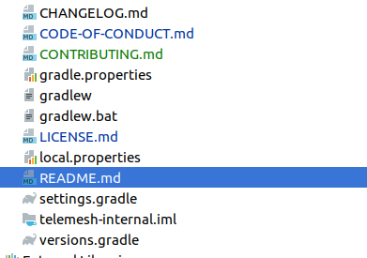
How to apply in Repo

Slide 8
Choosing a license
MIT, Apache 2.0, and GPLv3 are the most popular open source licenses.
The good news is that you can copy and paste an existing license into your repository. It will only take a minute to protect your hard work.
You must include a license when you launch an open source project.

Slide 9
Writing a README
In your README, try to answer the following questions:
What does this project do?
Why is this project useful?
How do I get started?
Where can I get more help, if I need it?
READMEs do more than explain how to use your project

Slide 10
Writing your contributing guidelines
you might include information on:
How to file a bug report (try using issue and pull request templates)
How to suggest a new feature
How to set up your environment and run tests
The types of contributions you’re looking for
Your roadmap or vision for the project
How contributors should (or should not) get in touch with you
https://github.com/nayafia/contributing-template/blob/master/CONTRIBUTING-template.md
A CONTRIBUTING file tells your audience how to participate in your project.

Slide 11
How it helps?
For the repository owner, contribution guidelines are a way to communicate how people should contribute.
For contributors, the guidelines help them verify that they're submitting well-formed pull requests and opening useful issues.

Slide 12
How to define our own?
In the earliest stages of your project, your CONTRIBUTING file can be simple. You should always explain how to report bugs or file issues, and any technical requirements (like tests) to make a contribution.
Over time, you might add other frequently asked questions to your CONTRIBUTING file. Writing down this information means fewer people will ask you the same questions over and over again.
https://github.com/w3-engineers/telemesh/blob/feature/codeofconduct/CONTRIBUTING.md

Slide 13
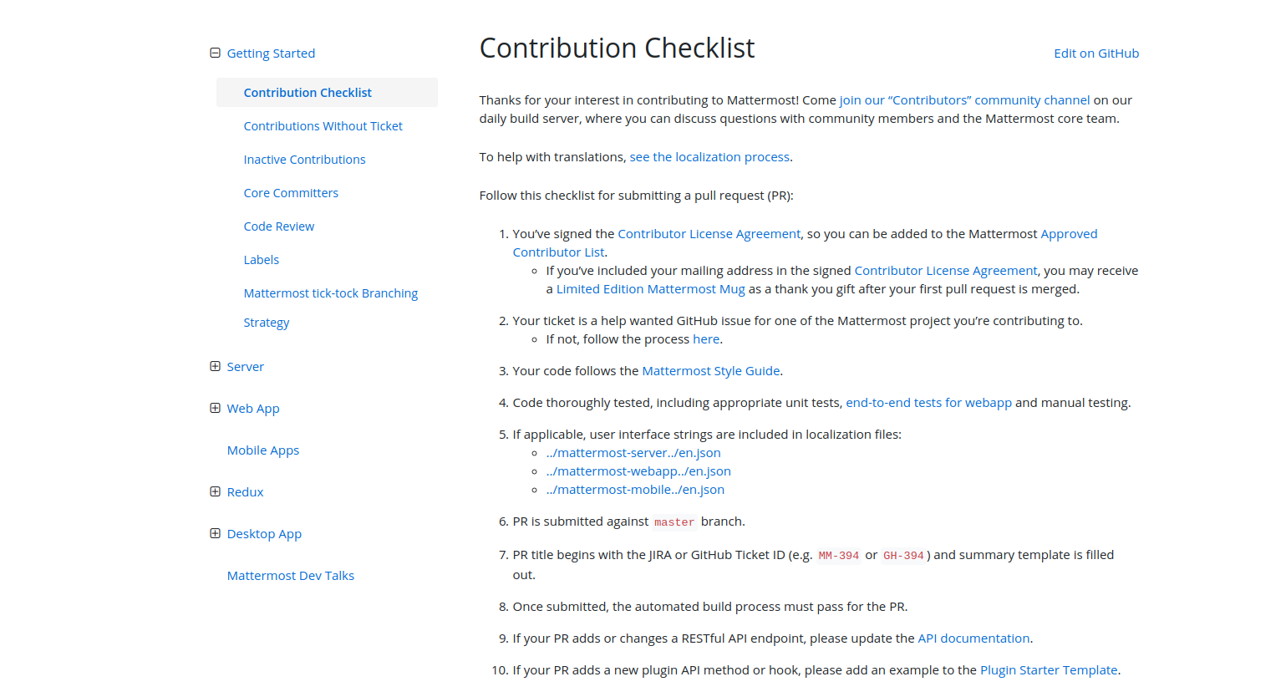
MatterMost Contribution Guideline
https://developers.mattermost.com/contribute/getting-started/contribution-checklist/

Slide 14
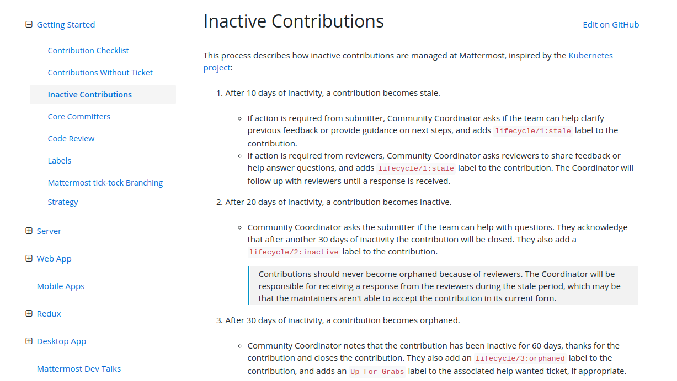
MatterMost Cont...

Slide 15
Mission Statement
A mission statement defines
what an organization is,
why it exists,
its reason for being.
a short written statement of your business goals and philosophies

Slide 16
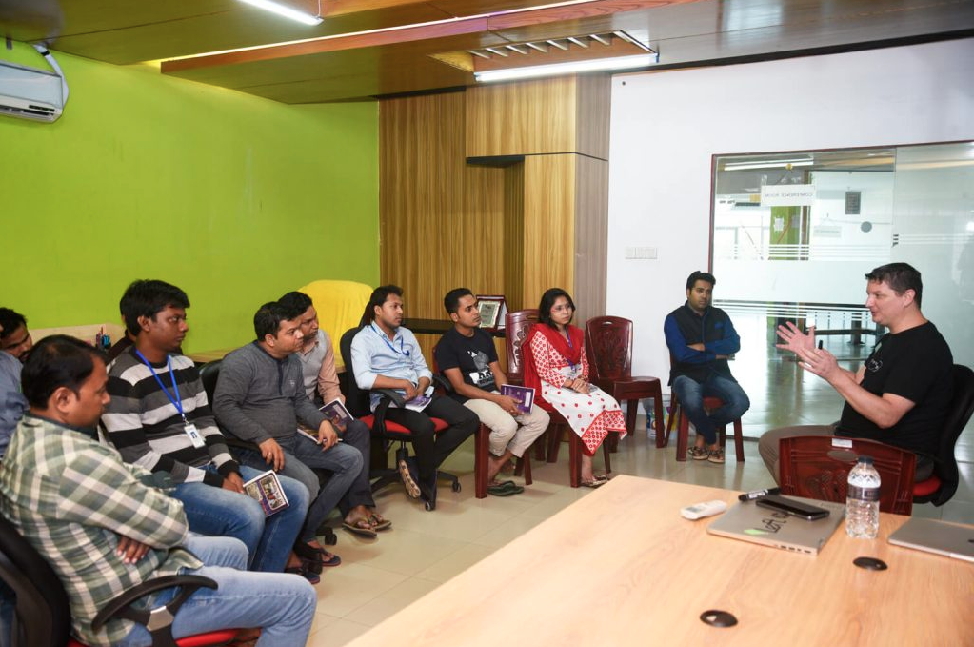
In your organization how most people react after executive team meeting ?
Wow, these executives are geniuses! What an inspiring statement. I'm so lucky to have an opportunity to work at a company with such bold leadership vision.
Hmm... sounds OK, and I'm sure it is meaningful to the executives. Do I have to memorize this?
What a bunch of crap?
What time does this meeting end and what is the lunch menu today?

Slide 17
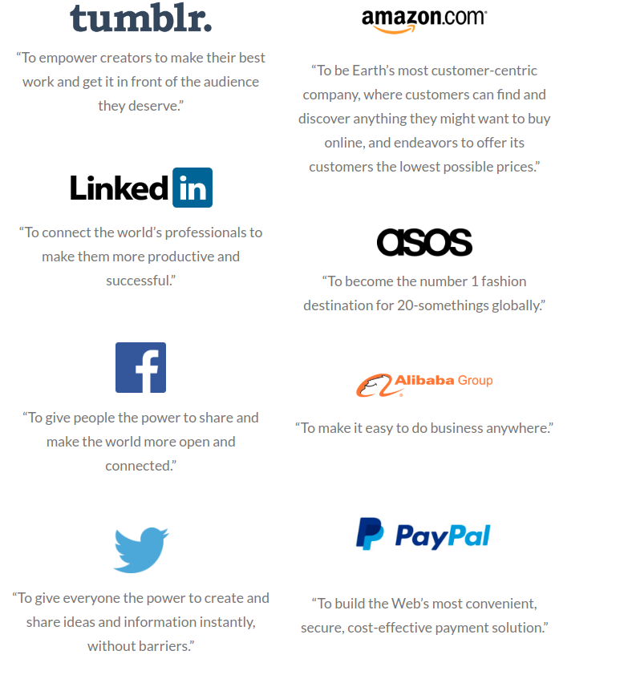
Mission Statement
https://www.alessiobresciani.com/foresight-strategy/51-mission-statement-examples-from-the-worlds-best-companies/
If you don't have a mission statement, create one by writing down in one sentence what the purpose of your business is.

Slide 18
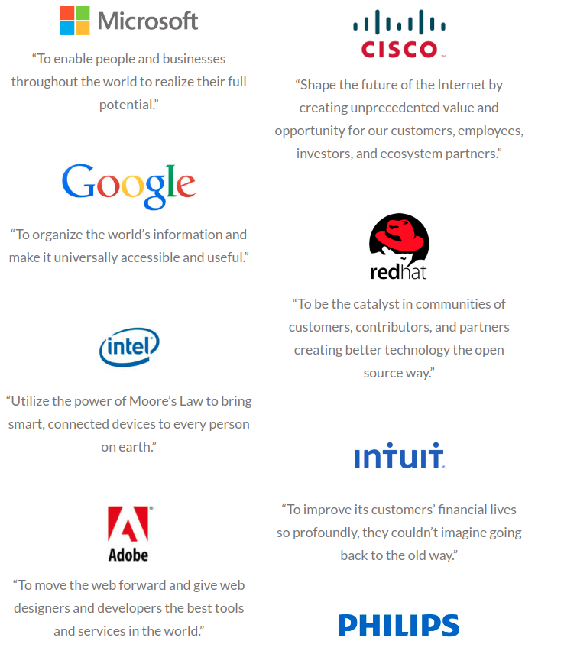
Mission Statement of Tech Giants
Ask two or three of the key people in your company to do the same thing. Then discuss the statements and come up with one sentence everyone agrees with.

Slide 19
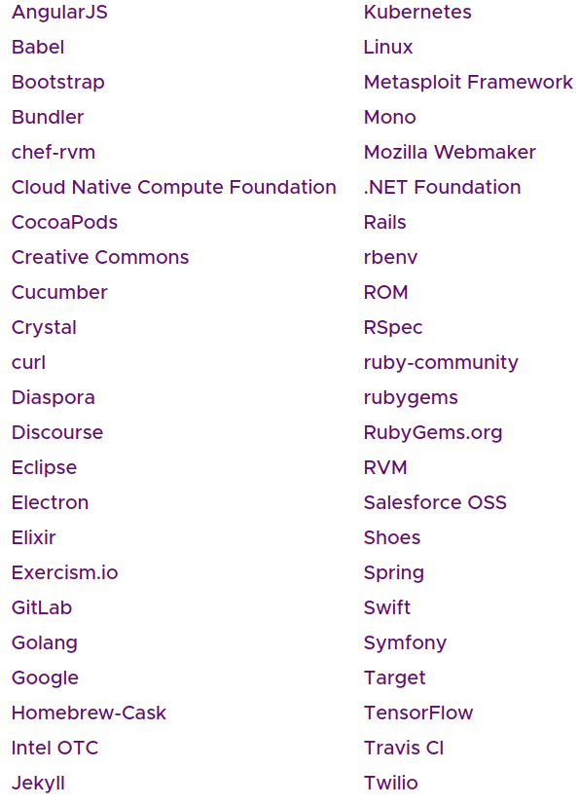
Establishing a code of conduct
a code of conduct helps set ground rules for behavior for your project’s participants.
The Contributor Covenant template has already been adopted by over 200,000 open source projects.

Slide 20
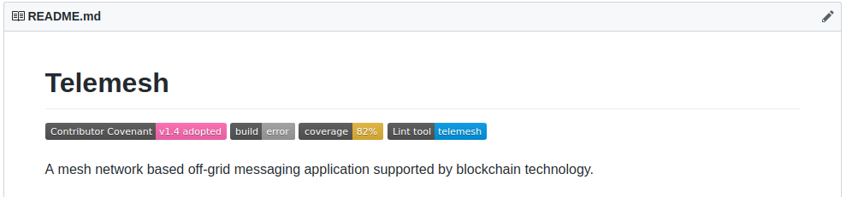
How to add this code of conduct in public repo
If you are using a markdown README file in your source code repository, you may want to add a badge like this one
Important things to consider
Contact Method
Enforcement Manual

Slide 21
Contact Method
We must add a contact method to the placeholder in the document so that people know how to report violations. Now I have added a demo email address info@telemesh.net
that we need to change with something valid one.
https://github.com/w3-engineers/telemesh/blob/feature/codeofconduct/code-of-conduct.md Telemesh
https://travis-ci.community/t/code-of-conduct/64 Travis Ci

Slide 22
Code of Conduct Enforcement Manual
We need to prepare a manual where we will clearly state how we will enforce the code of conduct.
Django team has deployed their own which is public.
https://www.djangoproject.com/conduct/enforcement-manual/
The Django Software Foundation's Board of Directors ("the board") establish this committee, comprised of at least three members.

Slide 23
What we need to make in future for Open Source Community
Mission Statement (Need a sentence that clearly identify the mission and goal from the executive panel)
Contributors Guideline (Add the beginning we can use Github’s template)
Pull request Guideline
Commit Message Guideline
Issue tracker
Git maintainer
Code of Conduct (Already added the covenant template)
Enforcement of code of conduct violation

Slide 24

Mission Statement of Telemesh
https://telemesh.net/

Slide 25
Thanks..

